Slide 1
AZ-203.1 Module 01: Implement solutions that use virtual machines (VM)
Subtitle or speaker name
Notes:
In this module, you will cover:
Provision VMs
Create Azure Resource Manager templates
Configure Azure Disk Encryption for VMs

Slide 2
Topics
Provision virtual machines (VMs)
Configure virtual machines (VMs)
Create Microsoft Azure Resource Manager templates
Configure Azure Disk Encryption for VMs
Notes:
These are the topics that will be covered in this module.

Slide 3
Lesson 01: Provision VMs
Notes:
In this lesson, you will cover:
Azure Virtual Machine creation checklist.
Azure Virtual Machine creation and management options.
Manage the availability of your Azure VMs.
Create an Azure VM by using the Azure portal.
Create an Azure VM by using Windows PowerShell.
Create and manage Azure VMs by using C#.

Slide 4

Azure virtual machine creation checklist
Before you create a virtual machine (VM), you should consider the following:
Checklist
Network configuration
VM name
Location
Size
Pricing model
Storage
Operating system
Notes:
Provisioning VMs to Azure requires planning. The items listed above only provides a subset of the things one should consider before creating a VM.

Slide 5
Naming a VM
The VM name is used as the computer name, which is configured as part of the operating system
Rules:
Up to 15 characters for a Windows VM
Up to 64 characters for a Linux VM
Notes:
This name also defines a manageable Azure resource, and it's not trivial to change later. That means that you should choose names that are meaningful and consistent, so that you can easily identify what the VM does.

Slide 6
Naming a VM (continued)
Current best practices for VM name choices:
Element | Example | Notes
Environment | dev, prod, QA | Identifies the environment for the resource
Location | uw (US West), ue (US East) | Identifies the region into which the resource is deployed
Instance | 01, 02 | For resources that have more than one named instance (such as web servers)
Product or Service | service | Identifies the product, application, or service that the resource supports
Role | sql, web, messaging | Identifies the role of the associated resource
Notes:
This table offers a set of best practices you can use when naming a VM.
For example, devusc-webvm01 might represent the first development web server hosted in the US South Central location.

Slide 7
VM pricing models
Two primary costs for every VM:
Storage – The cost of storing data in every virtual hard disk. This cost is independent of whether the VM is running
Compute – The usage-based price for compute capacity when the VM is currently allocated
There are two payment options for compute costs:
Pay as you go – Compute capacity is billed and paid as it is used without a long-term commitment
Reserved instances – Compute capacity can be pre-purchased at a reduced rate for anticipated usage
Notes:
There are two separate costs the subscription will be charged for every VM: compute and storage. By separating these costs, you scale them independently and only pay for what you need.
Compute costs – Compute expenses are priced on a per-hour basis but billed on a per-minute basis. For example, you are only charged for 55 minutes of usage if the VM is deployed for 55 minutes. You are not charged for compute capacity if you stop and deallocate the VM because this releases the hardware. The hourly price varies based on the VM size and OS you select. The cost for a VM includes the charge for the Windows operating system. Linux-based instances are less expensive because there is no operating system license charge.
Storage costs – You are charged separately for the storage the VM uses. The status of the VM has no relation to the storage charges that will be incurred; even if the VM is stopped/deallocated and you aren’t billed for the running VM, you will be charged for the storage used by the disks.
Pay as you go – With the pay-as-you-go option, you pay for compute capacity by the second, with no long-term commitment or upfront payments. You're able to increase or decrease compute capacity on demand and start or stop at any time. Prefer this option if you run applications with short-term or unpredictable workloads that cannot be interrupted. For example, if you are doing a quick test, or developing an app in a VM, this would be the appropriate option.
Reserved Virtual Machine Instances – The Reserved Virtual Machine Instances (RI) option is an advance purchase of a virtual machine for one or three years in a specified region. The commitment is made up front, and in return, you get up to 72% price savings compared to pay-as-you-go pricing. RIs are flexible and can easily be exchanged or returned for an early termination fee. Prefer this option if the VM must run continuously, or if you need budget predictability and you can commit to using the VM for at least a year.

Slide 8
VM storage options
Virtual disks can be backed by either Standard or Premium Storage accounts
Azure Premium Storage leverages solid-state drives (SSDs) to enable high performance and low latency for VMs running I/O-intensive workloads
You can choose either unmanaged disks or managed disks
Notes:
Azure Storage is the Microsoft cloud-based data storage solution. It supports almost any type of data and provides security, redundancy, and scalable access to the stored data. A Storage account provides access to objects in Azure Storage for a specific subscription. VMs always have one or more storage accounts to hold each attached virtual disk.
Use Azure Premium Storage for production workloads, especially those that are sensitive to performance variations or are I/O intensive. For development or testing, Standard storage is suitable.

Slide 9
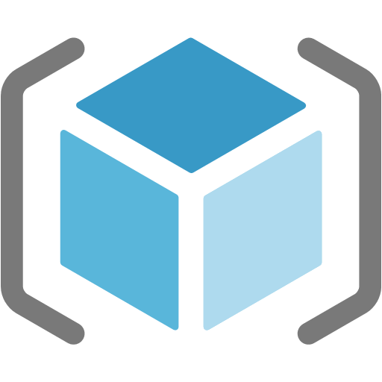


Managed and unmanaged disks
Managed disks
The Azure platform manages the disk and the backing storage
You don't have to worry about storage account limits and thresholds
Unmanaged disks
You manually create and manage virtual hard disks (VHDs) in your Storage account
You will need to consider account throughput and capacity limits when using this model
Storage
Unmanaged disks
Resource Group
Managed disk
Managed disk
Notes:
Managed disks. Managed disks are the newer and recommended disk storage model. They elegantly solve this complexity by putting the burden of managing the storage accounts onto Azure. You specify the size of the disk, which can be up to 4 terabytes (TB), and Azure creates and manages both the disk and the storage. You don't have to worry about storage account limits, which makes managed disks easier to scale out than managed discs.
Unmanaged disks. With unmanaged disks, you’re responsible for the storage accounts that hold the virtual hard disks (VHDs) that correspond to your VM disks. You pay the storage account rates for the amount of space you use. A single storage account has a fixed-rate limit of 20,000 input/output (I/O) operations per second. This means that a storage account is capable of supporting 40 standard VHDs at full utilization. If you need to scale out with more disks, then you'll need more storage accounts, which can get complicated.

Slide 10
Azure virtual machine creation and management
Azure portal
Browser-based user interface that allows you to create and manage all your Azure resources
Azure Resource Manager
Allows you to create templates, which can be used to create and deploy specific configurations of multiple Azure resources
Azure PowerShell
Optional package that adds Azure-specific commands to PowerShell
Azure CLI
Cross-platform command-line tool for managing Azure resources
Programmatic (APIs)
Notes:
Azure portal
The Azure portal provides an easy-to-use browser-based user interface that allows you to create and manage all your Azure resources. For example, you can set up a new database, increase the compute power of your virtual machines, and monitor your monthly costs. It's also a great learning tool, because you can survey all available resources and use guided wizards to create the ones you need.
Azure Resource Manager
Typically, your Azure infrastructure will contain many resources, many of them related to one another in some way. For example, the VM that we created has the virtual machine itself, storage, network interface, web server, and a database—all created together to run the WordPress site. Azure Resource Manager makes working with these related resources more efficient. It organizes resources into named resource groups that let you deploy, update, or delete all of the resources together. When we created the WordPress site, we identified the resource group as part of the VM creation, and Resource Manager placed the associated resources into the same group.
Azure PowerShell
PowerShell is a cross-platform shell that provides services like the shell window and command parsing. Azure PowerShell is an optional add-on package that adds the Azure-specific commands (referred to as cmdlets). You can learn more about installing and using Azure PowerShell in a separate training module.
Azure CLI
The Azure CLI is the Microsoft cross-platform command-line tool for managing Azure resources such as virtual machines and disks from the command line. It's available for macOS, Linux, and Windows, or in the browser by using the Cloud Shell. Like Azure PowerShell, the Azure CLI is a powerful way to streamline your administrative workflow. Unlike Azure PowerShell, the Azure CLI does not need PowerShell to function.
Programmatic (APIs)
Generally speaking, both Azure PowerShell and Azure CLI are good options if you have simple scripts to run and want to use only command-line tools. When it comes to more complex scenarios, where the creation and management of VMs form part of a larger application with complex logic, you can choose to interact with every type of resource in Azure programmatically.

Slide 11
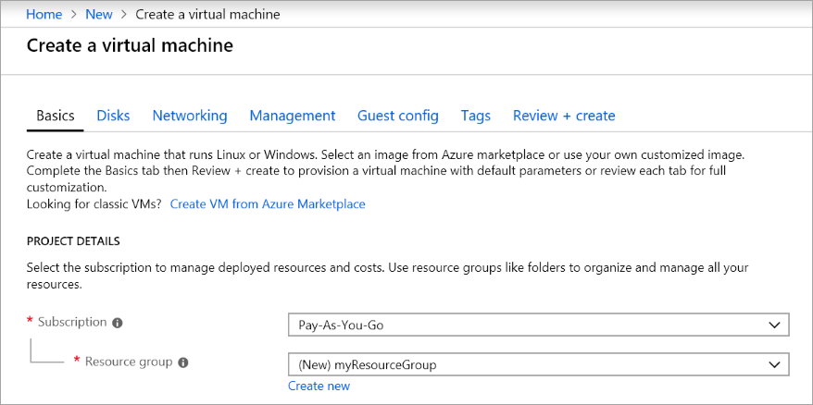
Create an Azure VM by using the Azure portal
Notes:
Azure virtual machines (VMs) can be created through the Azure portal. This method provides a browser-based user interface to create VMs and their associated resources.

Slide 12
Demo: Create an Azure VM by using the Azure portal
Notes:
Azure virtual machines (VMs) can be created through the Azure portal. This method provides a browser-based user interface to create VMs and their associated resources. This tutorial shows you how to use the Azure portal to deploy a virtual machine (VM) in Azure that runs Windows Server 2016. To examine your VM in action, you then RDP to the VM and install the IIS web server.
This revision of the course does not ship with demo instructions. For each demo, you will be given a list of specific tasks you should demonstrate to your students. The flow, content and structure of your demo is left to you to decide as an instructor.
In this demo, you should show students how to:
Create a VM using the workflow in the Azure Portal
Create a VM using the Azure CLI and the az vm create command

Slide 13
Create an Azure VM by using PowerShell
Connect-AzAccount
New-AzResourceGroup -Name myResourceGroup -Location EastUS
New-AzVm `
-ResourceGroupName "myResourceGroup" `
-Name "myVM" `
-Location "East US" `
-VirtualNetworkName "myVnet" `
-SubnetName "mySubnet" `
-SecurityGroupName "myNetworkSecurityGroup" `
-PublicIpAddressName "myPublicIpAddress" `
-OpenPorts 80,3389
Notes:
The Azure PowerShell module is used to create and manage Azure resources from the PowerShell command line or in scripts.
Launch Azure Cloud Shell
If you choose to install and use the PowerShell locally, this tutorial requires the new Az Azure PowerShell module version 1.0 (or later). Run Get-Module -ListAvailable Az* to find the version, you also need to run Connect-AzAccount to create a connection with Azure.
Create resource group
Create an Azure resource group with New-AzResourceGroup. A resource group is a logical container into which Azure resources are deployed and managed.
Create a virtual machine
Create a VM with New-AzVM. Provide names for each of the resources and the New-AzVM cmdlet creates if they don't already exist.

Slide 14
Accessing an Azure VM by using PowerShell
Get-AzPublicIpAddress -ResourceGroupName "myResourceGroup" | Select "IpAddress“
mstsc /v:publicIpAddress
Install-WindowsFeature -name Web-Server –IncludeManagementTools
Notes:
The Azure PowerShell module is used to create and manage Azure resources from the PowerShell command line or in scripts.
Connect to virtual machine
After the deployment has completed, RDP to the VM. To examine the public IP address of the VM, use the Get-AzPublicIpAddress cmdlet. Create a remote desktop session from your local computer. Replace the IP address with the public IP address of your VM.
Install web server
To examine your VM in action, install the IIS web server using PowerShell.

Slide 15
Demo: Create an Azure VM by using PowerShell
Notes:
The Azure PowerShell module is used to create and manage Azure resources from the PowerShell command line or in scripts. This tutorial shows you how to use the Azure PowerShell module to deploy a VM in Azure that runs Windows Server 2016. To examine your VM in action, you then RDP to the VM and install the IIS web server.
This revision of the course does not ship with demo instructions. For each demo, you will be given a list of specific tasks you should demonstrate to your students. The flow, content and structure of your demo is left to you to decide as an instructor.
In this demo, you should show students how to:
Use the Azure PowerShell module to create a VM
Access the details of the newly created VM using Azure PowerShell

Slide 16

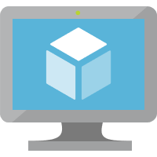


Capturing performance diagnostics for a VM
Report
VM
Azure Portal
Run PerfInsights
Notes:
The performance diagnostics tool helps you troubleshoot performance issues that can affect a Windows VM. Supported troubleshooting scenarios include quick checks on known issues and best practices, and complex problems that involve slow VM performance or high usage of CPU, disk space, or memory. You can run performance diagnostics directly from the Azure portal, where you can also review insights and a report on various logs, rich configuration, and diagnostics data. Performance diagnostics installs a VM extension that runs a diagnostics tool that is named PerfInsights.

Slide 17



Recovering a failed VM by using a rescue VM
STOP
START
Snapshot
Failed VM
Rescue VM
Notes:
If an Azure VM is inaccessible, it may be necessary to attach the operating system (OS) disk to another Azure VM to perform the recovery steps.
To perform a recovery, you must:
Stop the failed VM.
Take a snapshot of the failed VM's OS disk.
Create a new temporary VM (rescue VM).
Attach the failed VM's OS disk as a data disk on the rescue VM.
Connect to the rescue VM to investigate and mitigate issues with the failed VM's OS disk.
Detach the failed VM's OS disk from the rescue VM.
Perform a disk swap to swap the failed VM's OS disk from the rescue VM back to the failed VM.
Remove the resources that were created for the rescue VM.

Slide 18
Lesson 02: Configure VMs
Notes:
In this lesson, you will cover:
Configuration Options
Computing Workloads
High Availability and Disaster Recovery
Image Sources
Auto-OS Guest Updates
VM Serial Console

Slide 19
Sizing a VM
Each VM size offers a variation of the following characteristics:
Processing power
Memory
Storage capacity
Based on the workload, you're able to choose from a subset of available VM sizes
Notes:
Rather than specify processing power, memory, and storage capacity independently, Azure provides different VM sizes that offer variations of these characteristics.
The best way to determine the appropriate VM size is to consider the type of workload your VM needs to run.

Slide 20
VM configuration options
Computational performance
1 virtual CPU (vCPU) - 128 vCPUs
Memory
1 gibibyte (GiB) - 4 tebibyte (TiB)
Disk storage
4GiB - 64TiB
Up 160,000 IOPs
Networking
30 GB Ethernet 100 GB InfiniBand
Availability
Single VM service-lvel agreement (SLA) 99.9% Multi AZ SLA 99.99%
Notes:
The size of the VM that you use is determined by the workload that you want to run. The size that you choose then determines factors such as processing power, memory, and storage capacity. Azure offers a wide variety of sizes to support many types of uses.
Each size provides a range of configuration options to support various workloads that may possibly run in Azure.

Slide 21
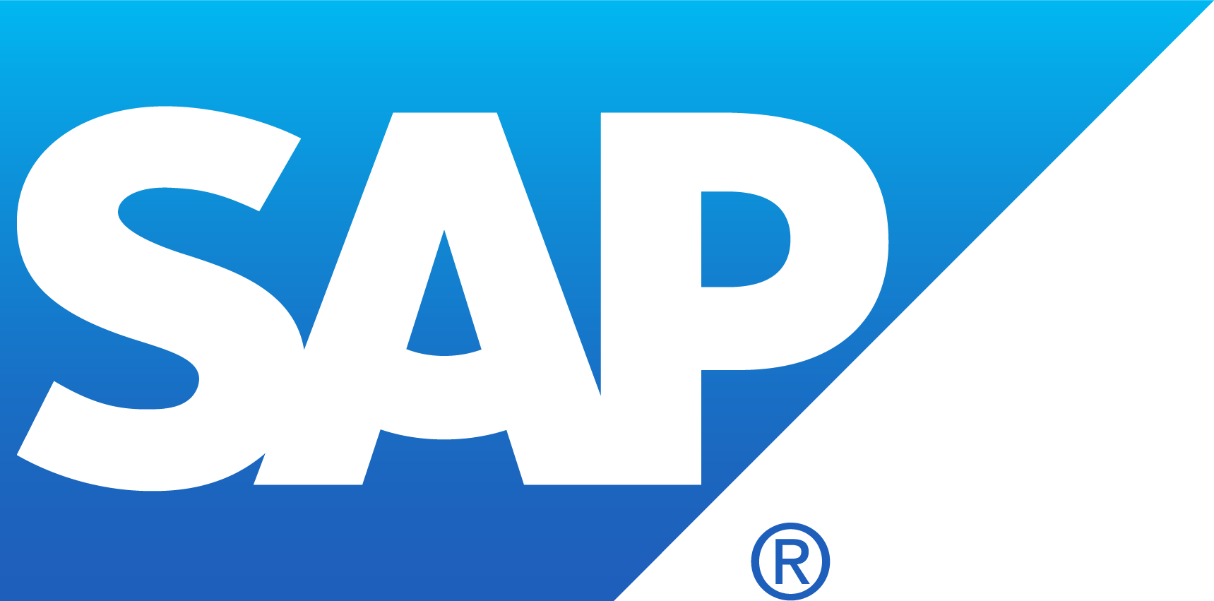
VM categories
Virtual machines
Purpose built
Entry level
Burstable
General purpose
Compute intensive
Memory optimized
GPU accelerated
High performance computing
Storage optimized
Notes:
You can design Azure Virtual Machines for a wide variety of workloads, starting from economical entry-level virtual machines to high-performance virtual machines for specialized workloads.
There are multiple categories listed here including:
Entry level. Economical, low-cost virtual machines for workloads that normally don't use a lot of CPU, but occasionally need to burst to handle higher workloads.
Burstable. Designed for workloads that will run for a long time by using a small fraction of the allocated CPU performance and then spike to the full power of the CPU due to incoming traffic or required work.
General purpose. Balanced CPU-to-memory ratio. Ideal for testing and development, small to medium databases, and low to medium traffic web servers.
Compute intensive. High CPU-to-memory ratio. Good for medium traffic web servers, network appliances, batch processes, and application servers.
Memory optimized. High memory-to-CPU ratio. Great for relational database servers, medium to large caches, and in-memory analytics.
GPU accelerated. Specialized virtual machines targeted for heavy graphic rendering and video editing as well as model training and inferencing (ND) with deep learning. Available with single or multiple GPUs.
High performance computing. Fastest and most powerful CPU virtual machines with optional high-throughput network interfaces (RDMA).
Storage optimized. High disk throughput and IO ideal for Big Data, SQL, NoSQL databases, data warehousing, and large transactional databases.

Slide 22
VM categories (cont.)
Option | Description
General purpose | General-purpose VMs are designed to have a balanced CPU-to-memory ratio. Ideal for testing and development, small to medium databases, and low to medium traffic web servers.
Compute optimized | Compute optimized VMs are designed to have a high CPU-to-memory ratio. Suitable for medium traffic web servers, network appliances, batch processes, and application servers.
Memory optimized | Memory optimized VMs are designed to have a high memory-to-CPU ratio. Great for relational database servers, medium to large caches, and in-memory analytics.
Storage optimized | Storage-optimized VMs are designed to have high disk throughput and IO. Ideal for VMs running databases.
GPU | GPU VMs are specialized virtual machines targeted for heavy graphics rendering and video editing. These VMs are ideal options for model training and inferencing with deep learning.
High performance compute | High-performance compute is the fastest and most powerful CPU virtual machine with optional high-throughput network interfaces.
Notes:
Rather than specify processing power, memory, and storage capacity independently, Azure provides different VM sizes that offer variations of these characteristics.
The best way to determine the appropriate VM size is to consider the type of workload your VM needs to run.

Slide 23
Manage the availability of your Azure VMs
Availability is the percentage of time a service is available for use
In the event of a physical failure within the Azure datacenter:
Azure will move the VM to a healthy host server automatically
“Self-healing” migration could take several minutes
If your VM is isolated to a single instance, the application(s) hosted on that VM will not be available
VMs could also be affected by periodic updates initiated by Azure itself
Notes:
What is availability?
Availability is the percentage of time a service is available for use. Let's assume you have a website and you want your customers to be able to access information at all times. Your expectation is 100% availability of concerning website access.
Azure VMs run on physical servers hosted within the Azure datacenter. As with most physical devices, there's a chance that there could be a failure. If the physical server fails, the virtual machines hosted on that server will also fail. If this happens, Azure will move the VM to a healthy host server automatically. However, this self-healing migration could take several minutes, during which the application(s) hosted on that VM will not be available.
Maintenance events range from software updates to hardware upgrades and are required to improve platform reliability and performance. These events usually are performed without impacting any guest VMs, but sometimes the virtual machines will be rebooted to complete an update or upgrade.

Slide 24
High availability and disaster recovery
Higher Latency
Region 1
Region 2
Region pairs
Protection from disaster with Data Residency compliance
Availability zones
Protection from entire datacenter failures
Availability sets / VM Scale Sets
Protection against failures within datacenters
Increased resiliency
Notes:
An availability set is a logical grouping of VMs within a datacenter that allows Azure to understand how your application is built to provide for redundancy and availability. Two or more VMs should be created within an availability set to provide for a highly available application and to meet the 99.95% Azure SLA. An availability set is composed of two additional groupings that protect against hardware failures and allow updates to safely apply—fault domains (FDs) and update domains (UDs).
Availability zones are alternatives to availability sets and expand the level of control you have over maintaining the availability of the applications and data on your VMs. An availability zone is a physically separate zone within an Azure region. There are three availability zones per supported Azure region. Each availability zone has a distinct power source, network, and cooling. By architecting your solutions to use replicated VMs in zones, you can protect your apps and data from the loss of a datacenter. If one zone is compromised, then replicated apps and data are instantly available in another zone.
Each Azure region is paired with another region within the same geography (such as US, Europe, or Asia), together making a region pair. This approach allows for the replication of resources, such as VM storage, across a geography. This should reduce the likelihood of natural disasters, civil unrest, power outages, or physical network outages affecting availability.

Slide 25
Availability sets
Availability set – logical feature used to ensure that a group of related VMs are deployed so that:
They are not all subject to a single physical point of failure
They are not all upgraded at the same time
Update domain – logical group of hardware that can undergo a maintenance update at the same time
Notes:
What is an availability set?
An availability set is a logical feature used to ensure that a group of related VMs are deployed so that they aren't all subject to a single point of failure and not all upgraded at the same time during a host operating system upgrade in the datacenter. VMs placed in an availability set should perform an identical set of functionalities and have the same software installed.
What is an update domain?
An update domain is a logical group of hardware that can undergo maintenance or be rebooted at the same time. Azure will automatically place availability sets into update domains to minimize the impact when the Azure platform introduces host operating system changes. Azure then processes each update domain one at a time.

Slide 26

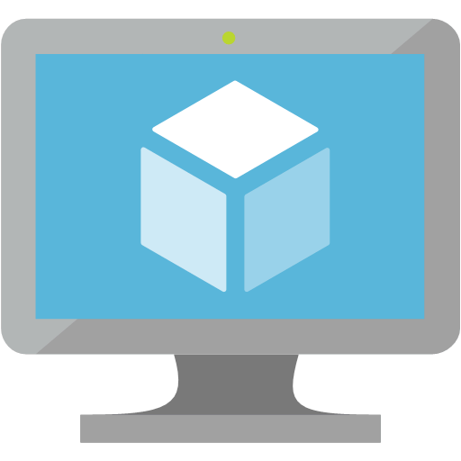

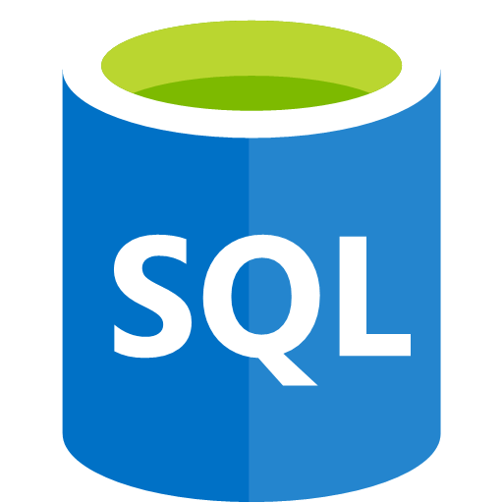
Fault domains
Fault domain – a logical group of hardware in Azure that shares a common power source and network switch
Fault domain
Fault domain
Rack
Rack
Virtual machine
Availability
set
Virtual machine
IIS1
IIS2
Virtual machine
Availability
set
Virtual machine
SQL1
SQL2
Notes:
What is a fault domain?
A fault domain is a logical group of hardware in Azure that shares a common power source and network switch. You can think of it as a rack within an on-premises datacenter. The first two VMs in an availability set will be provisioned into two different racks so that if the network or the power failed in a rack, only one VM would be affected. Fault domains are also defined for managed disks attached to VMs.

Slide 27
Image in Azure Marketplace
Images in Azure Marketplace are grouped into the following categories:
Publisher
Organization that creates an image
Offer
Group of related images
SKU
Instance of an offer, typically a release
Version
A specific release version number
Publisher
Offer
SKU
Notes:
A Marketplace image in Azure has the following attributes:
Publisher. The organization that created the image. Examples include Canonical and MicrosoftWindowsServer.
Offer. The name of a group of related images created by a publisher. Examples include UbuntuServer and WindowsServer.
SKU. An instance of an offer, such as a major release of a distribution. Examples include 18.04-LTS and 2019-Datacenter.
Version. The version number of an image SKU.
To identify a Marketplace image when you deploy a VM programmatically, supply these values individually as parameters.
Note: Images are unique to Azure regions and you may find a different list of images in each region.

Slide 28

Image Sources - Windows Server example
Microsoft Windows Server
Windows Server Semi-Annual
Windows Server
2012 Datacenter
2012-R2-Datacenter
2016-Datacenter
2016-Datacenter-Core
2016-Datacenter-with-Containers
2019-Datacenter
2019-Datacenter-Core
2019-Datacenter-with-Containers
PUBLISHER
2019.0.20181107
2019.0.20181122
2019.0.20181218
2019.0.20190115
2019.0.20190214
2019.0.20190314
2019.0.20190410
2019.0.20190603
2019.0.20190620
IMAGE
OFFER
IMAGE
OFFER
IMAGE
SKU
IMAGE
SKU
IMAGE
IMAGE
SKU
IMAGE
SKU
IMAGE
SKU
IMAGE
SKU
SKU
SKU
Notes:
In this example, we are looking for Windows Server 2019 Datacenter VM images. We can first find the Publisher (Microsoft Windows Server) and then list each offer made available by the publisher. After we find the Windows Server offer, we can look for the 2019 Datacenter SKU, and then an appropriate version image within that SKU.

Slide 29
Image Sources - Ubuntu example
Canonical
Ubuntu Core
Ubuntu Snappy
Ubuntu Server
12.04
14.04
16.04
18.04-LTS
18.10
19.04
19.10-DAILY
PUBLISHER
19.10.201905250
19.10.201905290
19.10.201905300
19.10.201905310
19.10.201906040
19.10.201906050
19.10.201906120
19.10.201906140
19.10.201906220
19.10.201906230
IMAGE
OFFER
IMAGE
IMAGE
OFFER
IMAGE
OFFER
IMAGE
SKU
IMAGE
SKU
IMAGE
SKU
IMAGE
SKU
IMAGE
IMAGE
SKU
SKU
SKU
Notes:
NEW SLIDE:
As another example, we can pull Ubuntu images by looking at the Canonical publisher. If we want the latest VM image for the Ubuntu Server offer, we can select the 19.10-DAILY SKU (the latest when this course was written), and then find the latest versioned image.

Slide 30
Image Uniform Resource Name (URN)
Short-hand string to quickly access a known VM image Format
PUBLISHER:OFFER:SKU:VERSION
MicrosoftWindowsServer
WindowsServer
SKU
Version
Offer
Publisher
2019-Datacenter
2019.0.20190603
Canonical
UbuntuServer
19.10-DAILY
19.10.201906230
Notes:
Some tools accept an image Uniform Resource Name (URN), which combines the attributes of the image, separated by the colon (:) character.
In an URN, you can replace the version number with "latest", which selects the latest version of the image.

Slide 31
Finding image sources by using the Azure CLI
# Get a list of all publishers available in the East US region
az vm image list-publishers --location eastus
# Get a list of all offers for the MicrosoftWindowsServer publisher
az vm image list-offers --location eastus --publisher MicrosoftWindowsServer
# Get a list of SKUs for the WindowsServer offer
az vm image list-skus --location eastus --publisher MicrosoftWindowsServer --offer WindowsServer
# Get a list of all images available for the 2019-Datacenter SKU
az vm image list --all --location eastus --publisher MicrosoftWindowsServer --offer WindowsServer --sku 2019-Datacenter
Notes:
You can search for images by using the Azure Command-Line Interface (CLI).
Use the az vm image list-publishers command to list publishers in your region. Then, use the az vm image list-offers command to list offers for the MicrosoftWindowsServer publisher. Next, use the az vm image list-skus command to list the SKUs for the WindowsServer offer.
Finally, use the az vm image list command to list all image versions for the 2019-Datacenter SKU. This command has a special all parameter that is used to get a list of all images from the server. Typically, the list of images is cached to your local machine and commands are executed against that cached list.

Slide 32
Finding image sources by using the Azure CLI (cont.)
# Get the 2019.0.20190603 version of the VM image
az vm image show --location eastus --publisher MicrosoftWindowsServer --offer WindowsServer --sku 2019-Datacenter --version 2019.0.20190603
# Alternatively, use an URN to get the specified version of the VM image
az vm image show --location eastus --urn MicrosoftWindowsServer:WindowsServer:2019-Datacenter:2019.0.20190603
Notes:
After you have an image version, you can use all the four attributes to find the specific image that you need.
You can use the az vm image show command in two ways:
You can specify all four parameters including publisher, offer, sku, and version. This will pull your specific image.
Alternatively, you can use the URN to get the same image by only using the urn parameter.

Slide 33
Finding image sources by using Azure PowerShell
# Get a list of all publishers available in the East US region
Get-AzVMImagePublisher -Location eastus
# Get a list of all offers for the Canonical publisher
Get-AzVMImageOffer -Location eastus -PublisherName Canonical
# Get a list of SKUs for the UbuntuServer offer
Get-AzVMImageSku -Location eastus -PublisherName Canonical -Offer UbuntuServer
# Get a list of all images available for the 19.10-DAILY SKU
Get-AzVMImage -Location eastus -PublisherName Canonical -Offer UbuntuServer -Sku 19.10-DAILY
Notes:
You can also search for images by using Azure PowerShell.
This example will look very similar to the Azure CLI example. You use the Get-AzVMImagePublisher cmdlet to find publishers, the Get-AzVMImageOffer cmdlet to find offers, and then the Get-AzVMImageSku cmdlet to find an appropriate SKU. After you’ve all of your metadata, you can get a list of image versions by using the generic Get-AzVMImage cmdlet.

Slide 34
Finding Image Sources using Azure PowerShell (cont.)
# Get the 19.10.201906230 version of the VM image
Get-AzVMImage -Location eastus -PublisherName Canonical -Offer UbuntuServer -Sku 19.10-DAILY -Version 19.10.201906230
Notes:
PowerShell has a unique workflow where you re-use the Get-AzVMImage cmdlet to first find all the image versions, and then find a specific image.
In this example, the difference in the code is that you specify the -Version parameter to get a specific VM image.

Slide 35
Azure Shared Image Gallery
Service to manage your images
Provides
Global replication
Versioning
Grouping
High availability
Image sharing across subscriptions
Image replicas
Shared Image Gallery
Image definition 1
Image definition 2
1.0.0
1.0.1
2.02
1.0.0
1.0.1
1.0.2
Version
Version
Version
Version
Version
Version
1.0.3
1.0.4
1.0.5
Version
Version
Version
Image definition 3
Image definition N
1.0.0
2.0.0
3.0.0
1.0.0
Version
Version
Version
Version
Notes:
Shared Image Gallery is a service that helps you build structure and organization around your managed images.
The Shared Image Gallery service provides:
Managed global replication of images.
Versioning and grouping of images for easier management.
Highly available images with Zone Redundant Storage (ZRS) accounts in regions that support availability zones. ZRS offers better resilience against zonal failures.
Sharing across subscriptions, and even between Active Directory (AD) tenants, using role-based access control (RBAC).
Scaling your deployments with image replicas in each region.

Slide 36
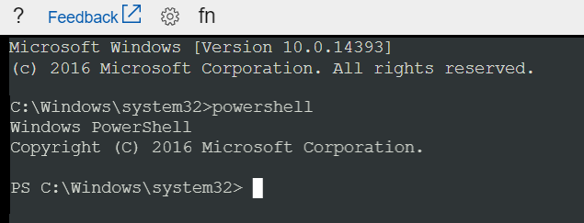
VM Serial Console
Console access to a VM independent of network or OS state
Available in Linux or Windows
Bash, CMD, PowerShell, NMI, SysRq, vi, GRUB, etc…
Notes:
The Serial Console in the Azure portal provides access to a text-based console for virtual machines (VMs). This serial connection connects to the ttys0 serial port for Linux VMs and COM1 serial port for Windows VMs.
The Serial Console provides access to the VM independent of the network or operating system state. The serial console can only be accessed by using the Azure portal.

Slide 37
Lesson 03: Create Azure Resource Manager templates
Notes:
In this lesson, you will cover:
Azure Resource Manager
Resource Manager template deployment
Create Resource Manager templates by using the Azure portal
Create Resource Manager templates by using Visual Studio Code

Slide 38





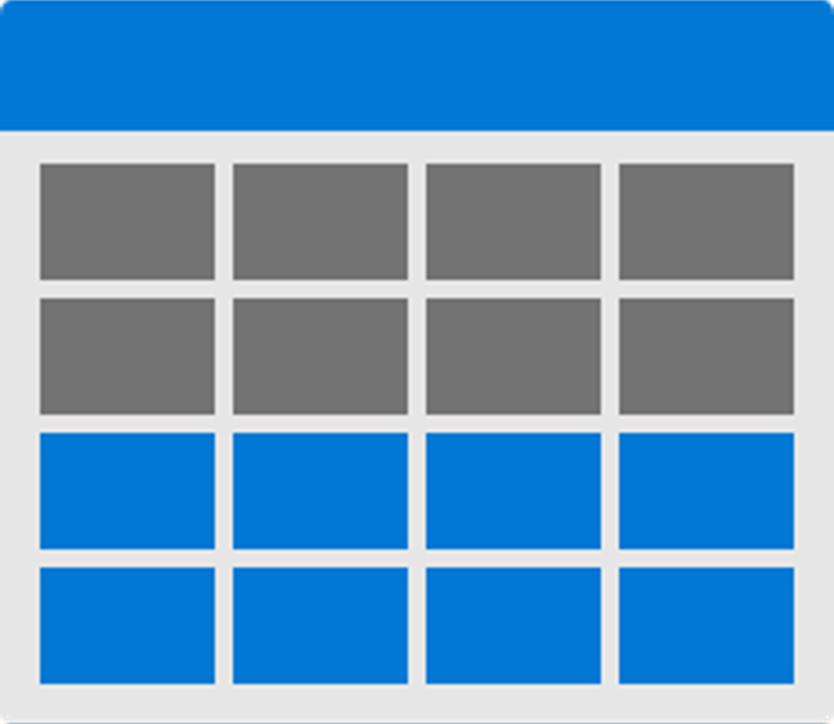


Azure Resource Manager overview
Resource Manager provides a consistent management layer to perform tasks
Azure PowerShell
Azure CLI
Azure portal
REST API
Client SDKs
+
+
Tools
Portal
Command line
Visual Studio
AZURE RESOURCE MANAGER API
RESOURCE MANAGER
ADFS
AAD
+
Cloud
On-Premises
RESOURCE PROVIDER CONTRACT
Provider
REST Points
…
…
Notes:
Consistent management layer
Resource Manager provides a consistent management layer to perform tasks through Azure PowerShell, Azure CLI, Azure portal, REST API, and client SDKs. All capabilities that are available in the Azure portal are also available through Azure PowerShell, Azure CLI, the Azure REST APIs, and client SDKs. Functionality initially released through APIs will be represented in the portal within 180 days of initial release.

Slide 39
Terminology
Resource
Single manageable item available through Azure
Resource group
Container holding related resources
Resource provider
Service that supplies resource instances in accordance with a predefined contract
Resource Manager template
JSON file that defines one or more resources, specifying their resource providers, to be deployed to a resource group
Declarative syntax
The act of describing your resources by using a template instead of manually creating the resources
Notes:
Resource
A manageable item that is available through Azure. Some common resources are a virtual machine, storage account, web app, database, and virtual network, but there are many more.
Resource group
A container that holds related resources for an Azure solution. The resource group can include all the resources for the solution, or only those resources that you want to manage as a group. You decide how you want to allocate resources to resource groups based on what makes the most sense for your organization.
Resource provider
A service that supplies the resources that you can deploy and manage through Resource Manager. Each resource provider offers operations for working with the resources that are deployed. Some common resource providers are Microsoft.Compute, which supplies the virtual machine resource, Microsoft.Storage, which supplies the storage account resource, and Microsoft.Web, which supplies resources related to web apps.
Resource Manager template
A JavaScript Object Notation (JSON) file that defines one or more resources to deploy to a resource group. It also defines the dependencies between the deployed resources. The template can be used to deploy the resources consistently and repeatedly.
Declarative syntax
Syntax that lets you state "Here is what I intend to create" without having to write the sequence of programming commands to create it. The Resource Manager template is an example of declarative syntax. In the file, you define the properties for the infrastructure to deploy to Azure.

Slide 40
Resource Manager template deployment
"resources": [
{
"apiVersion": "2016-01-01",
"type": "Microsoft.Storage/storageAccounts",
"name": "mystorageaccount",
"location": "westus",
"sku": {
"name": "Standard_LRS"
},
"kind": "Storage",
"properties": {}
}
]
PUT
https://management.azure.com/subscriptions/{subscriptionId}/resourceGroups/{resourceGroupName}/providers/Microsoft.Storage/storageAccounts/mystorageaccount?api-version=2016-01-01
REQUEST BODY
{
"location": "westus",
"properties": {},
"sku": {
"name": "Standard_LRS"
},
"kind": "Storage"
}
Notes:
With Resource Manager, you can create a template (in JSON format) that defines the infrastructure and configuration of your Azure solution. By using a template, you can repeatedly deploy your solution throughout its lifecycle and have confidence that your resources are deployed in a consistent state. When you create a solution from the portal, the solution automatically includes a deployment template. You don't have to create your template from scratch because you can start with the template for your solution and customize it to meet your specific needs. You can also retrieve a template for an existing resource group by either exporting the current state of the resource group, or viewing the template used for a particular deployment. Viewing the exported template is a helpful way to learn about the template syntax.

Slide 41


Three-tier Azure Resource Manager template
Three-tier application through a single Resource Manager template
3 tier
template
SQL DB
App
Service
Virtual
Machine
reference()
Reference Group
Notes:
How you define templates and resource groups is entirely up to you and how you want to manage your solution. For example, you can deploy your three-tier application through a single template to a single resource group.

Slide 42
Nested Resource Manager template
Nested templates deploying a similar three-tier application
Parent template
Nested
DB
template
Nested
Web
template
Nested
VM
template
SQL DB
App
Service
Virtual
Machine
reference()
Reference Group
Notes:
You don't have to define your entire infrastructure in a single template. Often, it makes sense to divide your deployment requirements into a set of targeted, purpose-specific templates. You can easily reuse these templates for different solutions. To deploy a particular solution, you create a master template that links all the required templates. The following image shows how to deploy a three tier solution through a parent template that includes three nested templates.
If you envision your tiers having separate lifecycles, you can deploy your three tiers to separate resource groups. Notice the resources can still be linked to resources in other resource groups.

Slide 43
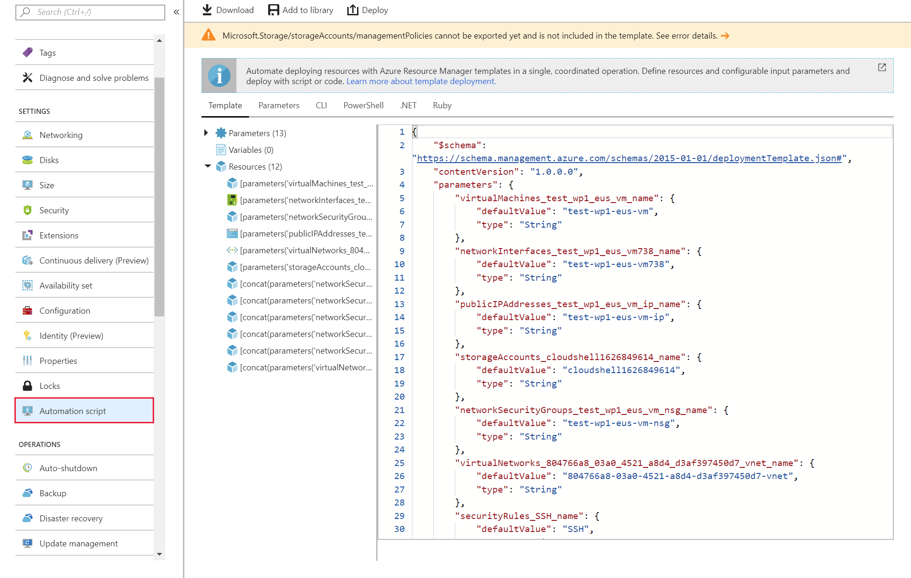
Create Resource Manager templates by using the Azure portal
Notes:
Resource Manager templates are JSON files that define the resources that you need to deploy for your solution.
You can create resource templates from the Settings section for a specific VM by selecting the Automation script option.

Slide 44
Demo: Create Resource Manager templates by using the Azure portal
Notes:
Learn how to create your first Azure Resource Manager template by generating one using the Azure portal, and the process of editing and deploying the template from the Azure portal. Resource Manager templates are JSON files that define the resources you need to deploy for your solution. The instructions in this tutorial create an Azure Storage account. You can use the same process to create other Azure resources.
This revision of the course does not ship with demo instructions. For each demo, you will be given a list of specific tasks you should demonstrate to your students. The flow, content and structure of your demo is left to you to decide as an instructor.
In this demo, you should show students how to:
Create one or more resources within the same Resource Group in the Azure Portal
Use the Automation Template section of the Resource Group blade to generate an ARM template

Slide 45
Create ARM templates by using Azure CLI
az group create --name $resourceGroupName --location $location
az group deployment create --name $deploymentName --resource-group $resourceGroupName --template-file "azuredeploy.json“
az storage account show --resource-group $resourceGroupName --name $storageAccountName
Notes:
You can create Resource Manager templates in Visual Studio Code and use the Azure CLI to deploy the Resource Manager template.

Slide 46
Demo: Create Resource Manager templates by using Visual Studio Code
Notes:
Learn how to use Visual Studio Code and the Azure Resource Manager Tools extension to create and edit Azure Resource Manager templates. You can create Resource Manager templates in Visual Studio Code without the extension, but the extension provides autocomplete options that simplify template development.
This revision of the course does not ship with demo instructions. For each demo, you will be given a list of specific tasks you should demonstrate to your students. The flow, content and structure of your demo is left to you to decide as an instructor.
In this demo, you should show students how to:
Create a new ARM template file in Visual Studio Code
Use the ARM template extension to view metadata about resources in the template

Slide 47
Lesson 04: Azure Disk Encryption for VMs
Notes:
In this lesson, you will cover:
Encryption options for protecting VMs.
Encrypting existing VM disks.
Automating secure VM deployments by using Azure Resource Manager templates.

Slide 48
Encryption options for protecting VMs
Encryption converts meaningful information into something that seems meaningless, as a security measure
Typically, a key is used to perform the encryption and subsequent decryption
There are two forms of key-based encryption:
Symmetric – A single key is used to encrypt and decrypt the data for best performance
Asymmetric – A pair of keys is used to encrypt the data. Only one key is made “public” while both parties share a “private” key
Notes:
What is encryption?
Encryption is about converting meaningful information into something that appears meaningless, such as a random sequence of letters and numbers. The process of encryption uses some form of key as part of the algorithm that creates the encrypted data. A key is also needed to perform the decryption. Keys may be symmetric, where the same key is used for encryption and decryption, or asymmetric, where different keys are used. An example of the latter is the public-private key pairs used in digital certificates.
Symmetric encryption
Algorithms that use symmetric keys, such as Advanced Encryption Standard (AES), are typically faster than public key algorithms, and are often used for protecting large data stores. Because there's only one key, procedures must be in place to prevent the key from becoming publicly known.
Asymmetric encryption
With asymmetric algorithms, only the private key member of the pair must be kept private and secure; as its name suggests, the public key can be made available to anyone without compromising the encrypted data. The downside of public key algorithms, however, is that they're much slower than symmetric algorithms, and cannot be used to encrypt large amounts of data.

Slide 49
Key management
Key can be managed (by Azure) or managed manually by you
Managed disk protection technologies for Azure VMs are:
Storage Service Encryption (SSE) – Protects storage data at rest
Azure Disk Encryption (ADE) – Uses BitLocker to control the encryption of disks for Windows or Linux
Notes:
Key management
In Azure, your encryption keys can be managed by Microsoft or the customer. Often, the demand for customer-managed keys comes from organizations that need to demonstrate compliance with HIPAA or other regulations. Such compliance may require that access to keys is logged, and that regular key changes are made and recorded.
Storage Service Encryption
Azure Storage Service Encryption (SSE) is an encryption service built into Azure used to protect data at rest. The Azure storage platform automatically encrypts data before it's stored to several storage services, including Azure Managed Disks. Encryption is enabled by default by using 256-bit AES encryption, and is managed by the storage account administrator.
Azure Disk Encryption
Azure Disk Encryption (ADE) is managed by the VM owner. It controls the encryption of Windows and Linux VM-controlled disks, by using BitLocker on Windows VMs and DM-Crypt on Linux VMs. BitLocker Drive Encryption is a data protection feature that integrates with the operating system, and addresses the threats of data theft or exposure from lost, stolen, or inappropriately decommissioned computers. Similarly, DM-Crypt encrypts data at rest for Linux before writing to storage.

Slide 50
Create Azure Key Vault by using Azure PowerShell
New-AzKeyVault -Location "<location>" `
-ResourceGroupName "<resource-group>" `
-VaultName "myKeyVault" `
-EnabledForDiskEncryption
Notes:
Azure Key Vault
The encryption keys used by ADE can be stored in Azure Key Vault. Azure Key Vault is a tool for securely storing and accessing secrets. A secret is anything that you want to tightly control access to, such as API keys, passwords, or certificates. This provides highly available and scalable secure storage, as defined in Federal Information Processing Standards (FIPS) 140-2 Level 2 validated Hardware Security Modules (HSMs). By using Key Vault, you keep full control of the keys used to encrypt your data, and you can manage and audit your key usage.

Slide 51
Create Azure Key Vault by using Azure CLI
az keyvault create \
--name "myKeyVault" \
--resource-group <resource-group> \
--location <location> \
--enabled-for-disk-encryption True
Notes:
Azure Key Vault
The encryption keys used by ADE can be stored in Azure Key Vault. Azure Key Vault is a tool for securely storing and accessing secrets. A secret is anything that you want to tightly control access to, such as API keys, passwords, or certificates. This provides highly available and scalable secure storage, as defined in Federal Information Processing Standards (FIPS) 140-2 Level 2 validated Hardware Security Modules (HSMs). By using Key Vault, you keep full control of the keys used to encrypt your data, and you can manage and audit your key usage.

Slide 52
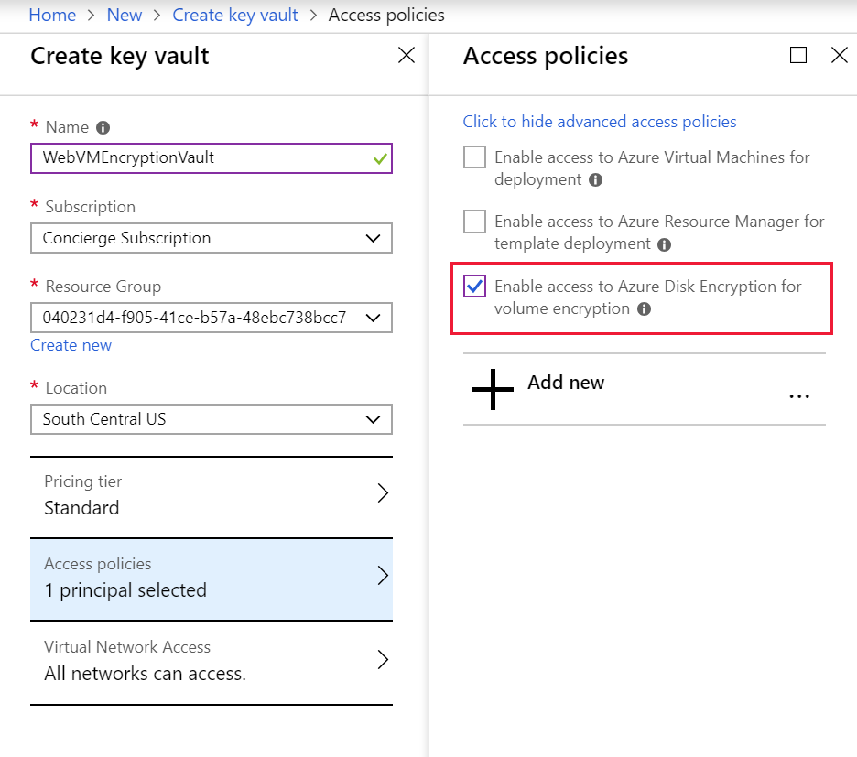
Encrypt existing VM disks by using the Azure portal
Notes:
An Azure Key Vault is a resource that can be created in the Azure portal by using the normal resource creation process.

Slide 53
Configuring Azure Key Vault to encrypt VM disks
You must enable access to keys or secrets to make them available to the VM
Granting access is done through policies
There are three policies that you can enable:
Disk Encryption – Required for Azure Disk Encryption
Deployment – Access secrets during deployment
Template Deployment – Access secrets in Resource Manager templates
Notes:
Enabling access policies in the key vault
Azure needs access to the encryption keys or secrets in your key vault to make them available to the VM for booting and decrypting the volumes. We covered this for the portal when we changed the Advanced access policies above.
There are three – Required for Azure Disk encryption.
Deployment – (Optional) Enables the Microsoft.Compute resource provider to retrieve secrets from this key vault when this key vault is referenced in resource creation, for example, when creating a virtual machine.
Template deployment – (Optional) Enables Azure Resource Manager to get secrets from this key vault when this key vault is referenced in a template deployment.

Slide 54
Encrypt existing VM disks by using Azure CLI
az keyvault update --name <keyvault-name> --resource-group <resource-group> --enabled-for-disk-encryption "true"
az vm encryption enable \
--resource-group <resource-group> \
--name <vm-name> \
--disk-encryption-keyvault <keyvault-name> \
--volume-type [all | os | data] \
--skipvmbackup
az vm encryption show --resource-group <resource-group> --name <vm-name>
Notes:
Enabling access policies in the key vault
Azure needs access to the encryption keys or secrets in your Key Vault to make them available to the VM for booting and decrypting the volumes. We covered this for the portal when we changed the Advanced access policies above.

Slide 55
Encrypt existing VM disks by using PowerShell
Set-AzKeyVaultAccessPolicy -VaultName <keyvault-name> -ResourceGroupName <resource-group> -EnabledForDiskEncryption
Set-AzVmDiskEncryptionExtension `
-ResourceGroupName <resource-group> `
-VMName <vm-name> `
-VolumeType [All | OS | Data]
-DiskEncryptionKeyVaultId <keyVault.ResourceId> `
-DiskEncryptionKeyVaultUrl <keyVault.VaultUri> `
-SkipVmBackup
Get-AzVmDiskEncryptionStatus `
-ResourceGroupName <resource-group> `
-VMName <vm-name>
Notes:
Encrypt your VM with Set-AzVMDiskEncryptionExtension using the Azure Key Vault key.
This example retrieves all the key information then encrypts the VM.

Slide 56
Demo: Encrypt existing VM disks
Notes:
Suppose your company has decided to implement Azure Disk Encryption (ADE) across all VMs. You need to evaluate how to roll out encryption to existing VM volumes. Here, we’ll examine the requirements for ADE, and the steps involved in encrypting disks on existing Linux and Windows VMs.
This revision of the course does not ship with demo instructions. For each demo, you will be given a list of specific tasks you should demonstrate to your students. The flow, content and structure of your demo is left to you to decide as an instructor.
In this demo, you should show students how to:
Use Azure PowerShell to encrypt an existing VM
Use Azure CLI to verify that a disk is encrypted

Slide 57
Review
Provision VMs
Configure VMs
Create Azure Resource Manager templates
Configure Azure Disk Encryption for VMs
Notes:
These are the topics that we discussed in this module.

